Slide 1
Term Project Presentation
Uzair Siddiqui

Slide 2
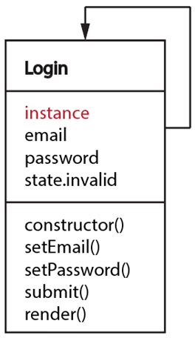
Login Component—Singleton

Slide 3
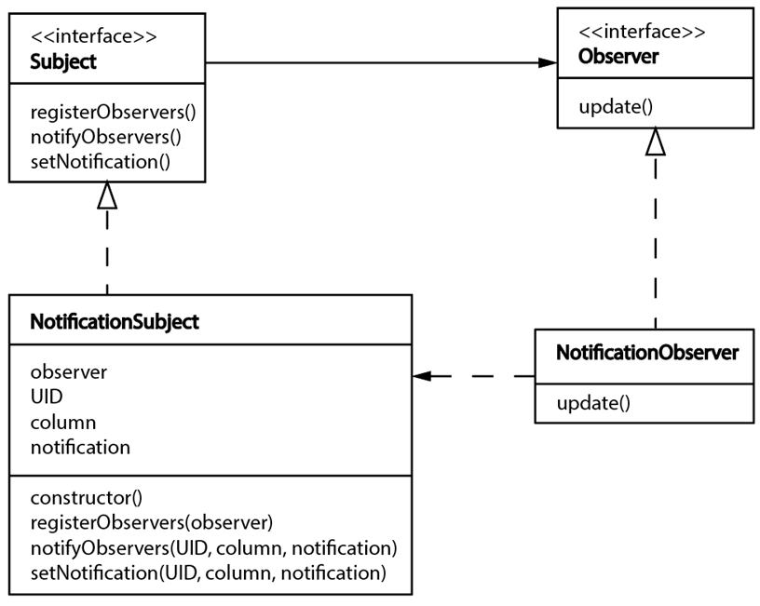
Notification Component—Observer
Subject interface
Observer interface
Concrete observer
Concrete subject

Slide 4
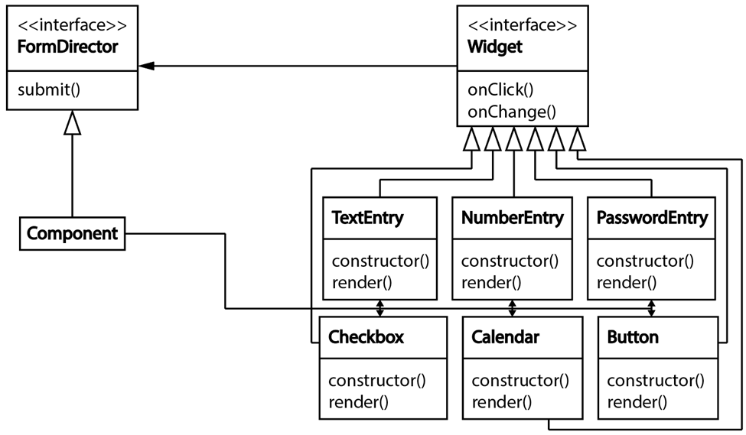
UI Components—Mediator
Mediator
Colleague
Concrete Mediator
Concrete Colleagues

Slide 5
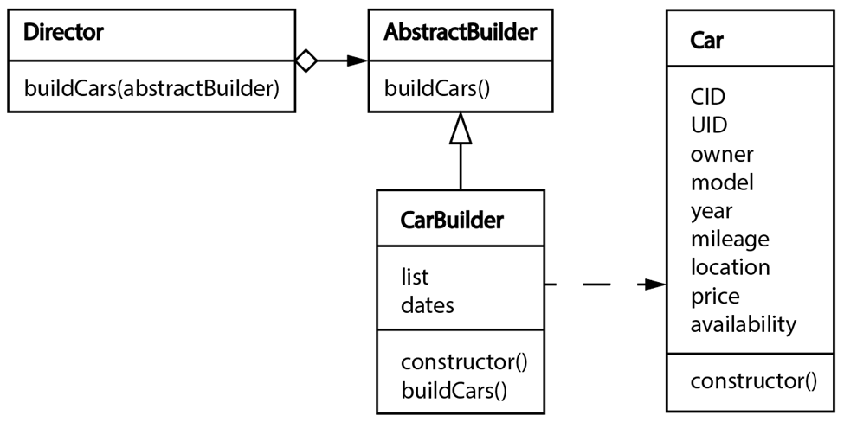
Car Listing Component—Builder
Builder
Director
Product
Concrete builder

Slide 6
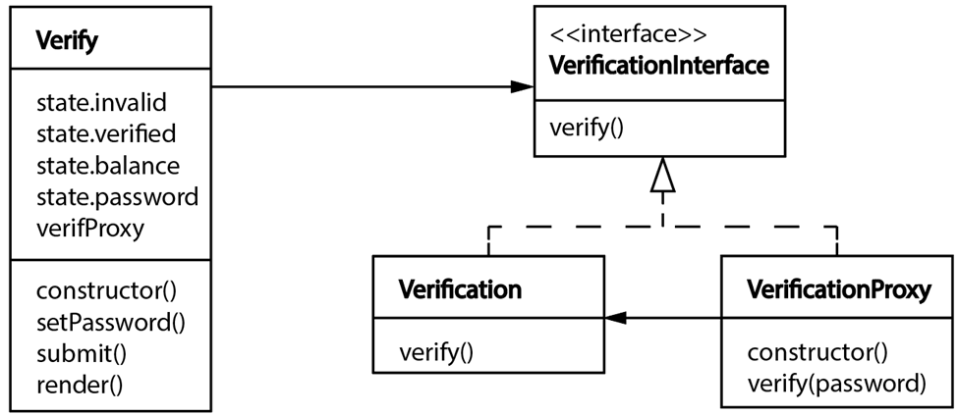
Renting Verification—Proxy
Subject
Client
Real subject
Proxy

Slide 7
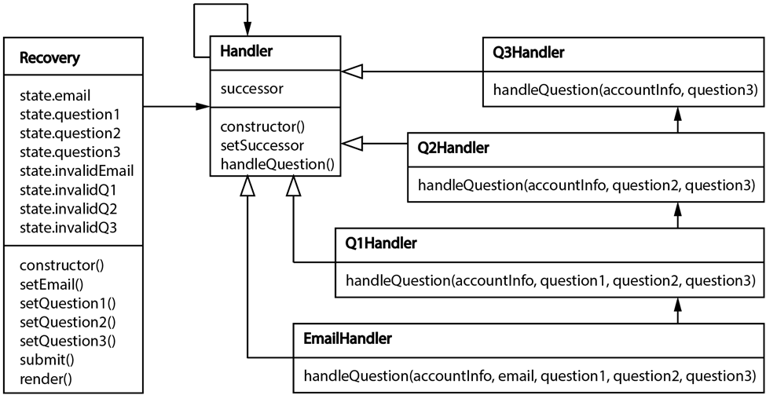
Recovery—Chain of Responsibility
Handler
Concrete Handlers
Client

Slide 8
Group Contributions and Task Summary
Everything: Me

